Slide 1

Emergency Vehicles Management: Optimizing Response Times
Managing emergency vehicles is a crucial aspect of public safety, ensuring efficient response times and optimal outcomes. This presentation explores the challenges, strategies, and technologies involved in optimizing emergency vehicle queues.

Slide 2

Introduction to Emergency Vehicles Management
1
Public Safety Lifeline
Emergency vehicles, like ambulances, fire trucks, and police cars, play a vital role in ensuring public safety and responding to incidents.
2
Efficiency is Paramount
Effective management of emergency vehicles is essential for minimizing response times and maximizing the impact of emergency services.
3
Queue Management: A Key Element
Queue management is a critical aspect of emergency vehicle management, designed to optimize vehicle flow and minimize delays.

Slide 3
Key Challenges in Managing Emergency Vehicles
Traffic Congestion
Coordination Gaps
High Call Volume
Traffic congestion is a significant challenge, causing delays and hindering emergency response.
Coordination between dispatch centers and emergency vehicles is vital for efficient response.
High call volume can lead to vehicle queues, increasing the risk of delayed response to critical situations.

Slide 4
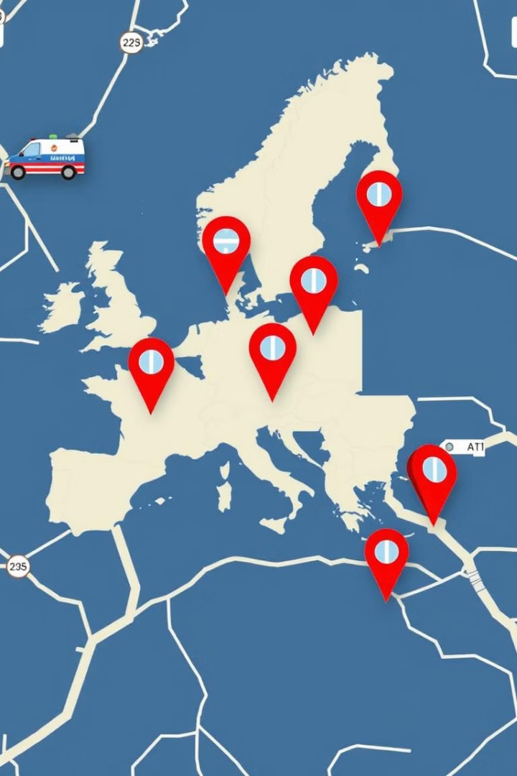
Understanding Queue Management
1
Definition
Queue management aims to optimize the flow of emergency vehicles, reducing wait times and ensuring timely responses.
2
Prioritization
Emergency vehicles are prioritized based on urgency and location, ensuring the most critical cases are addressed first.
3
Software and Systems
Sophisticated software and systems are used to manage queues, providing real-time data and optimizing vehicle routes.

Slide 5
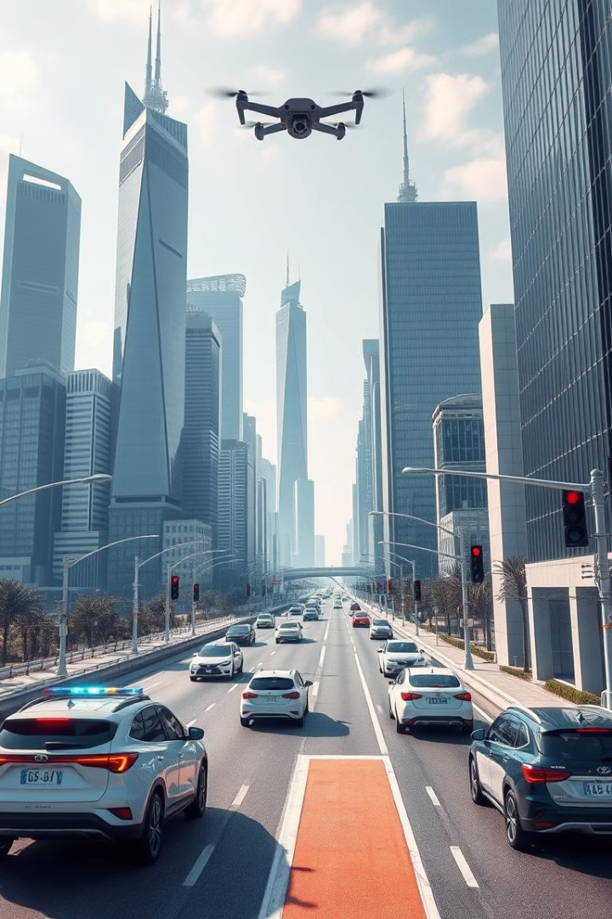
Strategies for Managing Emergency Vehicle Queues
Smart Traffic Systems
Implementing smart traffic systems with sensors and data analytics can optimize traffic flow and prioritize emergency vehicles.
Dynamic Routing
Dynamic routing systems utilize real-time traffic data to adjust routes and minimize delays for emergency vehicles.
Centralized Dispatch
Centralized dispatch control allows for real-time prioritization of emergency vehicle queues based on urgency.
Collaboration
Collaborating with local authorities to optimize traffic signals and manage road closures can streamline emergency vehicle movements.

Slide 6
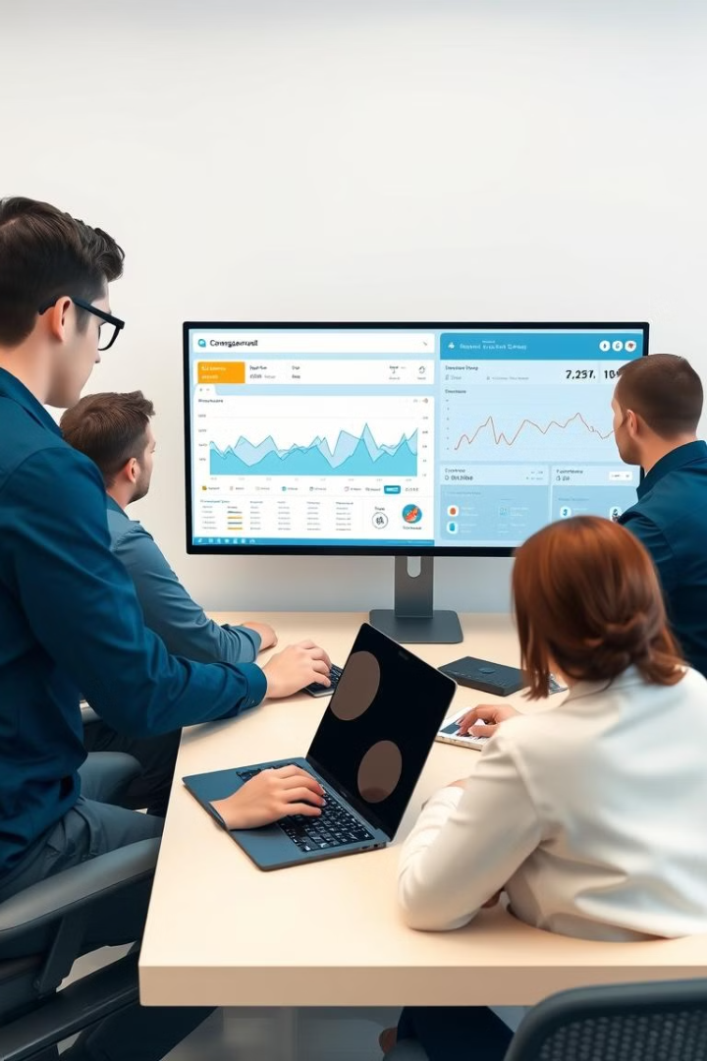



Role of Technology in Queue Management
AI and Machine Learning
AI and machine learning are increasingly used in route optimization, predicting traffic patterns and minimizing delays.
Real-Time Data Integration
Real-time traffic data integration provides valuable insights for routing, enabling dynamic adjustments and avoiding congestion.
Cloud-Based Dispatch Systems
Cloud-based dispatch systems facilitate centralized management of emergency vehicle queues, providing real-time information and coordination.

Slide 7
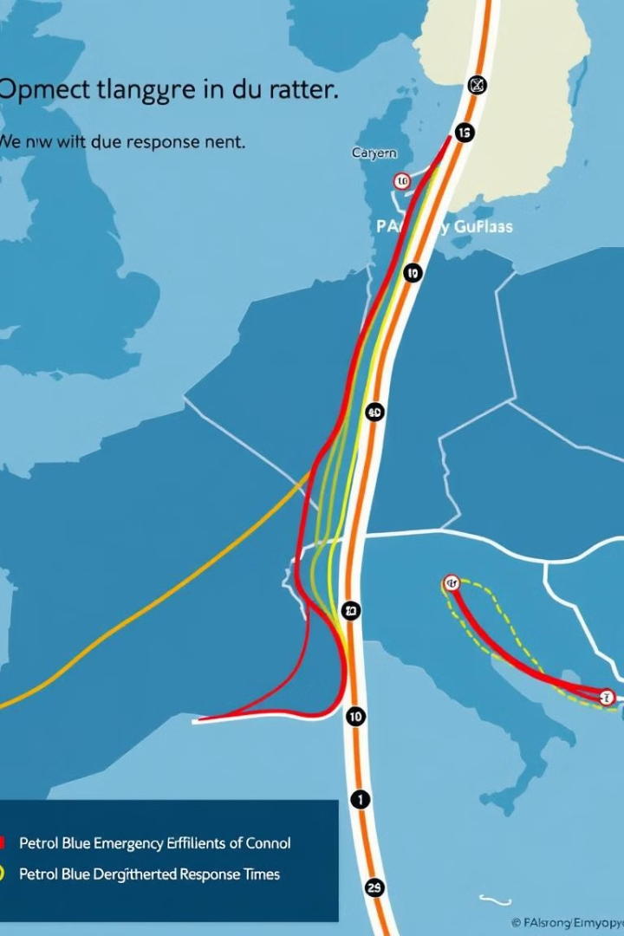
Benefits of Efficient Queue Management
Faster Response Times
Improved Patient Outcomes
Reduced Traffic Delays
Cost Savings
Enhanced Coordination
Increased Public Safety

Slide 8
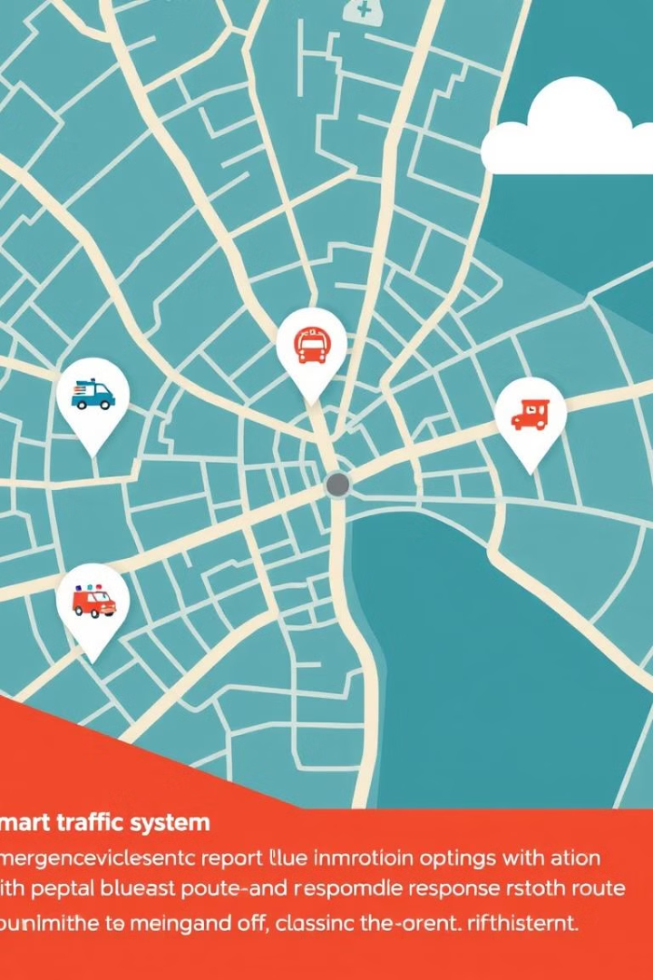


Real-world Examples of Effective Queue Management
City A
City A's smart traffic system prioritizes ambulances, optimizing their routes and reducing response times.
City B
City B's fire department utilizes AI for real-time dispatching, efficiently managing queues and ensuring prompt fire responses.

Slide 9

Conclusion and Future Directions for Queue Management
1
Key Takeaways
2
Future Trends
3
Continued Innovation
Efficient emergency vehicle management is vital for public safety, reducing response times, and improving outcomes.
Autonomous vehicles, AI-driven systems, and advanced technologies are expected to revolutionize emergency vehicle management in the future.
Continuous innovation and development of new technologies are essential to further reduce response times and optimize emergency services.

